Slide 1
DA Milestone -(Salary Insights and Compensation Trends)
BY :-
ABDUL KADHAR M
DADS/JULY

Slide 2
Project Objective
To analyze salary trends across industries, job titles, and countries
To identify factors influencing compensation – education, experience, and gender
To discover top-paying roles and industry gaps
To visualize data through interactive dashboards in Excel
To apply data analytics techniques for real-world HR insights

Slide 3
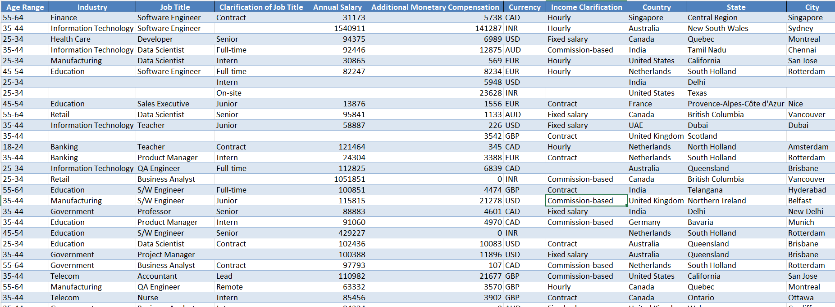
Dataset Overview
No. of records : 1021
No. of Columns : 16
Key Fields : Industry , Job Title ,Gender , Country , Salary(USD) , Experience , Education Level
Data Source : Salary Survey Dataset
Business Context : Provides global workforce compensation data to analyze the impact of experience , education ,and gender on pay equity

Slide 4
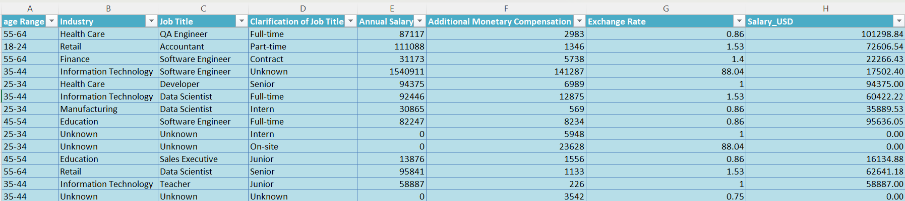
Data Cleaning & Preparation
Removed missing and duplicate entries
Standardized currency (USD) and column names
Converted date and numeric fields into consistent formats
Renamed columns (e.g., “Age Range” → “Age_Range”)
Built calculated columns for grouped averages and medians
Verified data consistency through SQL validation queries

Slide 5
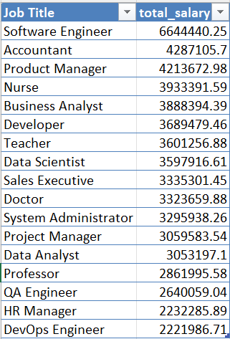
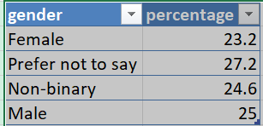
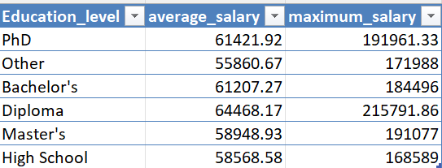
SQL Analysis Highlights
Average Salary by Industry and Gender
Salary Distribution by Education Level
Median Salary by Age Range and Gender
Highest Paying Job Titles per Country
Total Compensation by Job Title and Experience

Slide 6
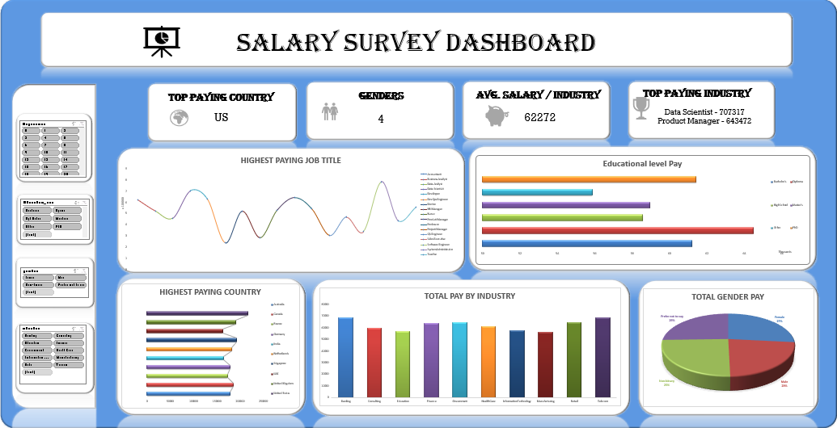
Dashboard Overview

Slide 7
Key Findings and Insights
Industry Impact: Technology and Finance industries have the highest pay scales.
Gender Disparity: Males earn slightly higher, especially in technical roles.
Education Influence: Master’s degree holders earn the most.
Experience Factor: Higher years = higher pay.
Top Roles: Data Scientists, Managers, and Analysts show top salaries.

Slide 8
KPI’S and Metrics
Average Salary (USD)
Total Compensation by Job Title
Employee Count by Experience Level
Salary Distribution by Education Level
Gender-Based Salary Percentage
Insight: These KPIs support HR policy formulation and equitable pay structure evaluation.

Slide 9
Data Driven Insights
Salary depends significantly on education and professional experience.
Gender-based salary variance is minimal in managerial roles.
Companies should prioritize education-based upskilling for fair growth.
Geographic salary differences indicate cost-of-living and demand variance.
Conclusion Insight:
“Analytics transforms raw data into actionable insights that support evidence-based HR and compensation decisions.”

Slide 10
Conclusion
The Salary Dataset Analysis provided valuable insights into how education level, experience, and industry significantly influence employee compensation.
Using SQL and Excel, salary patterns were analyzed across genders, job titles, and countries, revealing that higher education and greater experience lead to higher earnings.
The findings highlight the importance of data-driven HR decisions and support the need for fair pay structures and skill-based growth opportunities.

Slide 11
Thank you

